Slide 1
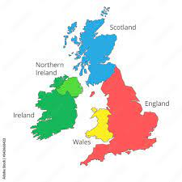
The UK
Scotland
The United Kingdom is made up of:
England
Scotland
Wales
Northern Ireland
Not the Republic of Ireland!
Northern Ireland
England
Ireland
Wales

Slide 2

Timeline – Prime Ministers in the UK
Rishi Sunak
(25th Oct. 2022-ongoing)
David Cameron (2010-2016)
Boris Johnson
(2019-5th Sept. 2022)
Theresa May (2016-2019)
Liz Truss
(6th Sept. 2022-
20th October 2022)

Slide 3
Brexit
1973: the UK joined the European Economic Community (EEC)
June 2016= Brexit referendum
(52% in favour of leaving EU)
June 2017= starting point of the negotiations
2020= end of negotiations

Slide 4
Remain or leave the EU? The key reasons
Remain | Leave
Economic stability: trade with European states | Sovereignty: more control of its laws and regulations
Consumer benefits: easy movement of goods, services and people across the states | Financial contributions: EU membership fees would be spent on issues that matter the most to the British people
Employment opportunities: need of skilled people in different working fields such as manufacturing and nursing | Selective immigration: control over its borders and points-based immigration system that gives preference to skilled workers

Slide 5
The political system in the UK
Form of government: constitutional monarchy with parliamentary government
Prime minister= head of the government
controlled by a Parliament
elected by the people

Slide 6
The political system in the UK
Form of government: constitutional monarchy with parliamentary government
The UK's constitution is not codified in a single document like in some other countries; instead, it consists of statutes, conventions, judicial decisions, and historical documents

Slide 7
Parliament
It is bicameral:
House of Lords | House of Commons
No fixed numbers of members | 650 members
Members are not elected: some are elected by the sovereign, others take over the role by inheritance (there is no fixed term) | Members are elected every 5 years voted by the general public
They work in the Palace of Westminster | They work in the Palace of Westminster

Slide 8
Parliament
The main functions of Parliament are:
to pass laws
control government policy and administration
discuss major issues affecting the country (international relations, education, climate change, etc.)

Slide 9
The most important parties
Conservatory Party: centre-right political party (generally supported by landowners and businesspeople)
Labour Party: centre-left political party (generally supported by the working class)
Liberal Democratic Party: it is socially progressive and supports economic liberalism
The Green Party: left-wing party, it is focused on the environmental issues

Slide 10
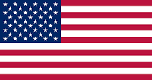
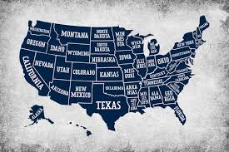
USA
Composed of 50 states
Born on 4th July 1776:
Declaration of Independence
(authorised by Thomas Jefferson)
it officially declared the colonies' independence from British rule

Slide 11
The political system in the USA
The United States are a constitutional, federal and presidential republic
The president is the Head of the State → presidential elections are held every four years

Slide 12
The political system in the USA
Constitution was adopted in 1787 and it outlines the national frame of the government
=
It:
Establishes the structure of the federal government
Sets the guidelines for the relationship between the federal government and the states
Expresses the rights of the citizens

Slide 13
Political parties
There are two predominant parties:
Democratic Party: centre-left, liberal party. Its voters are mainly in the North-East and West-Coast states. It is in favour of social and economic equality.
Republican Party: centre-right, conservative party. It is in favour of private business and conservatism.

Slide 14
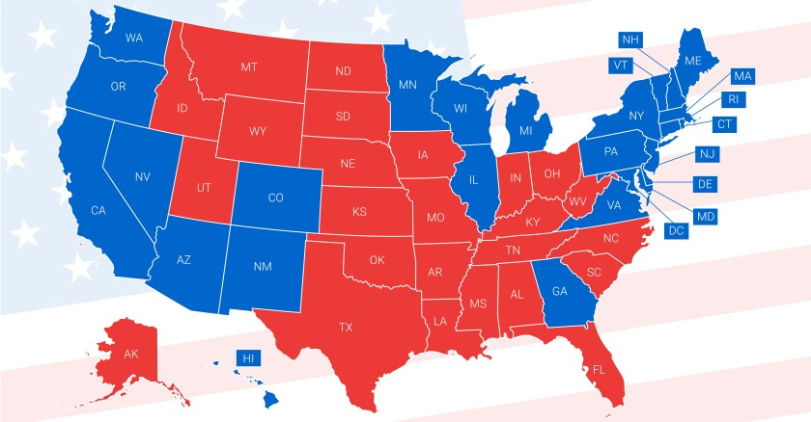
Political parties
mainly Republican
mainly Democratic

Slide 15

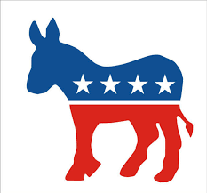
Symbols of the parties
Republican party: elephant
Associated with strength, wisdom and dignity
Democratic party: donkey
Associated with humility and perseverance

Slide 16
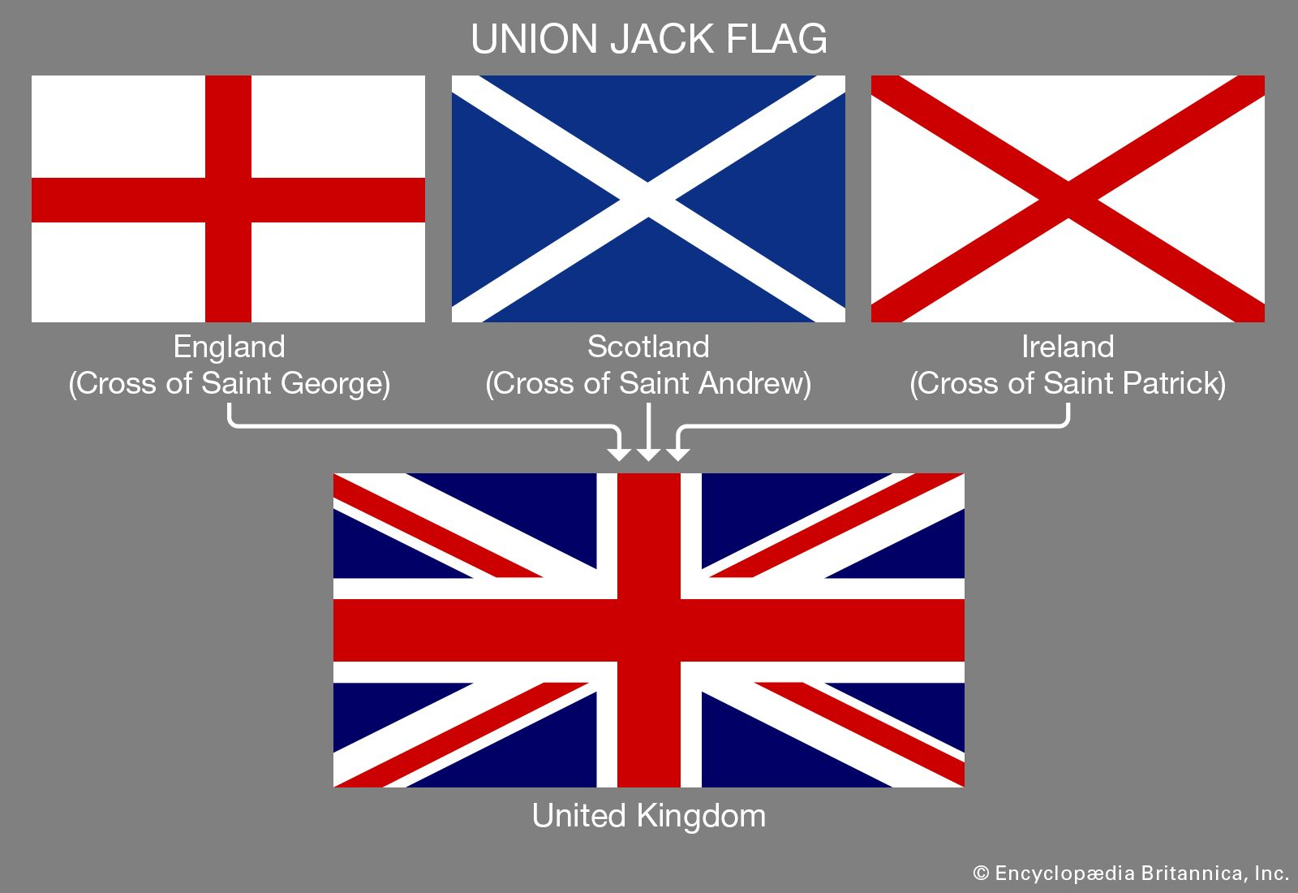
A comparison of flags
UK
Union Jack
The flag consists of:
the red cross of Saint George (patron saint of England)
The white cross saltire of Saint Andrew (patron saint of Scotland)
The red cross saltire of St Patrick (patron saint of Ireland)

Slide 17

A comparison of flags
USA
Stars and stripes
The flag consists of:
Thirteen horizontal stripes → 13 British colonies that declared independence from Great Britain
Fifty stars → 50 states

Slide 18
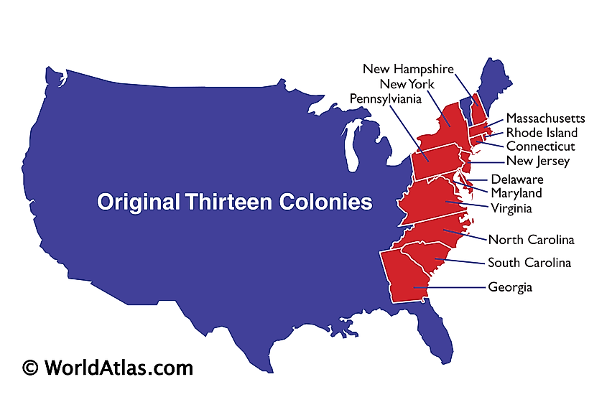

Slide 19

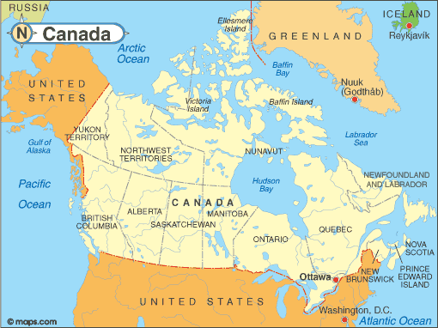
Canada
Capital city: Ottawa
Languages: English and French
Currency: Canadian dollar
Flag: the Maple Leaf
→ representation of the vast maple forests

Slide 20
Canada
= federal parliamentary state
Why?
Federal:
Practical and historical reasons:
1. Canada has a vast territory with cultural and linguistic diversity
→ A federal system allows these diverse regions to manage their local affairs while still being part of a unified nation

Slide 21
Canada
2. Canada was created through the union of several British colonies in North America (1867)
→ Each of these colonies had its own government and distinct identity. The federal system was a compromise that allowed these colonies to retain a degree of self-government within a larger federation

Slide 22
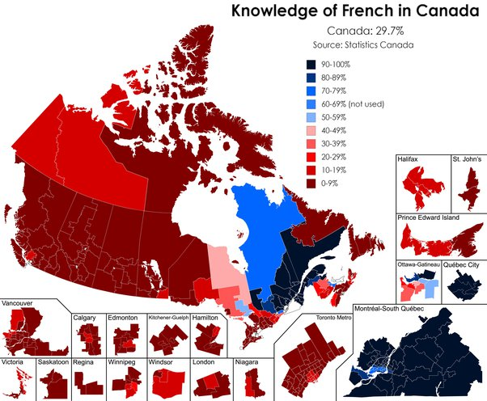

Slide 23
Why French and English?
Colonial History:
Before the arrival of Europeans, Canada was inhabited by various Indigenous people with their own languages and cultures
In the 16th century, French explorers began exploring and establishing colonies in the Quebec region and surrounding areas, initiating New France
In the 17th century English permanent settlements began to appear in the Eastern part of Canada

Slide 24
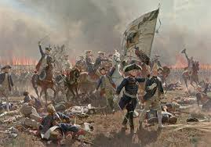
French-British Conflict:
In the 18th century, tensions between the French and British in North America led to various conflicts, culminating in the Seven Years' War (known in America as the French and Indian War)
With the Treaty of Paris in 1763, France ceded New France to the British, who took control of vast territories in North America

Slide 25
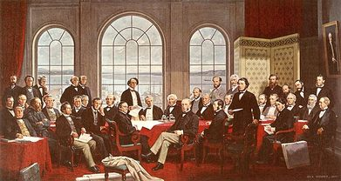
Formation of the Canadian Confederation (1867):
Canada began to develop an official policy of bilingualism, recognizing the importance of accommodating both linguistic communities
Official Languages Act (1969):
→ Recognized the equal status of English and French in all institutions of the federal government

Slide 26
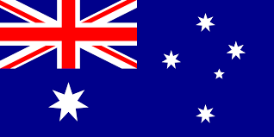
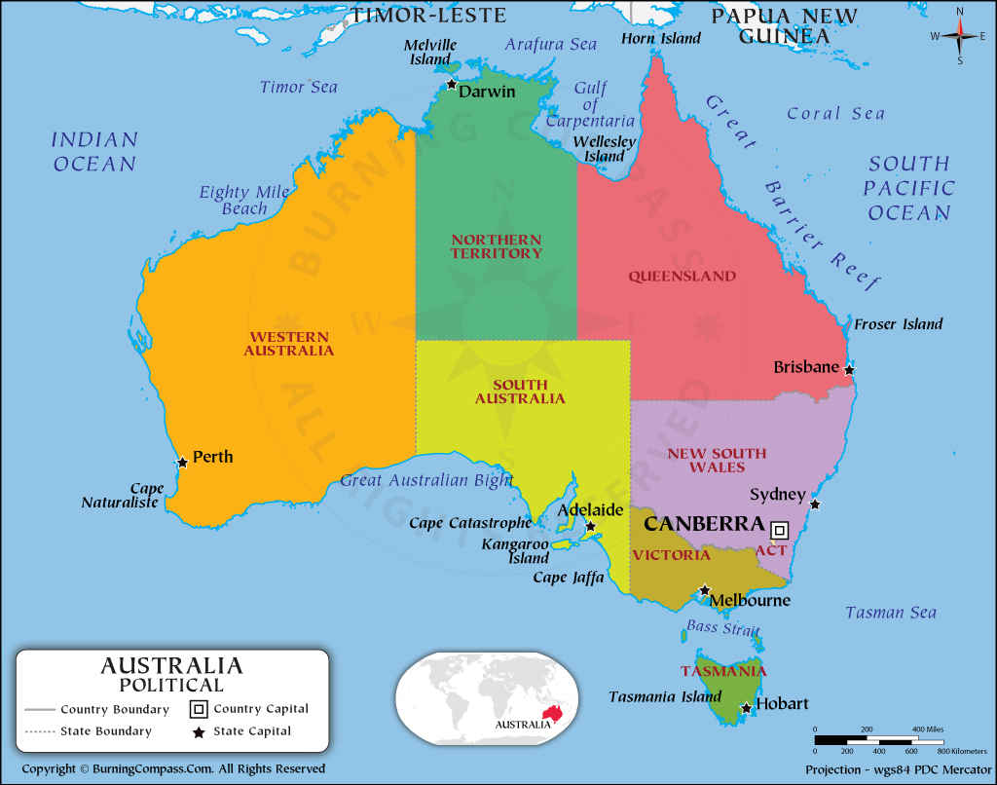
Australia
National capital city: Canberra
Main language: English
Currency: Australian dollar
Six states:
1. Sydney - Capital of New South Wales
2. Melbourne - Capital of Victoria
3. Brisbane - Capital of Queensland
4. Perth - Capital of Western Australia
5. Adelaide - Capital of South Australia
6. Hobart - Capital of Tasmania

Slide 27
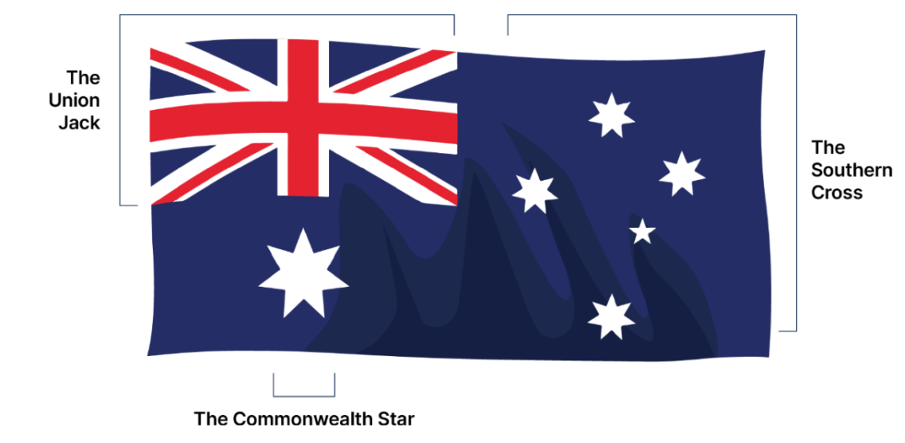
Australia
Flag:
Union Jack in the upper left corner: Australia’s history as a part of the British Empire
The commonwealth star: big seven-pointed star to denote the six states and the combined territories of the Commonwealth
The five smaller stars on the right are a depiction of the Southern Cross constellation, which is visible in the southern hemisphere and symbolizes Australia's geography

Slide 28
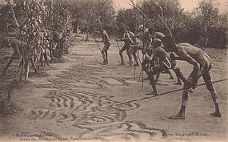
A brief history of Australia
Before the arrival of the European settlers, Australia was inhabited by indigenous people called “Aborigines”
“Aborigines” → term coined by the Europeans
“Kooris” → as Aborigines call themselves

Slide 29
A brief history of Australia
In the 1600s the Dutch reached Australia
In 1770: Captain James Cook claimed Australia for Britain
Result: when the European settlers arrived, the Aborigines suffered disastrously
During the 1700s (after the American Revolution), Britain transformed Australia into a penal colony

Slide 30
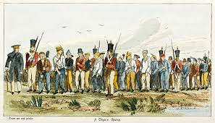
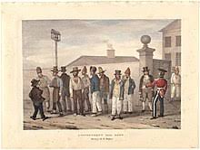
Australia as a penal colony

Slide 31
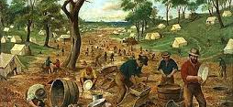
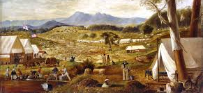
A brief history of Australia
In the early 1800s, Britain encouraged free citizens to emigrate to Australia offering them land and tools
In the second half of the 1800s, a gold rush brought a population boom

Slide 32
A brief history of Australia
As Australia was made up of separate colonies, in 1901 Britain helped the colonies unite into the independent Commonwealth of Australia
Result: Australia kept its ties to Britain by recognising the British monarch as the head of state
Actual political system: democracy

